Slide 1
The implement of decision tree algorithm
Done by: hayde elshike

Slide 2
The steps
Data preprocessing
Feature engineering
Hyperparameter tuning

Slide 3
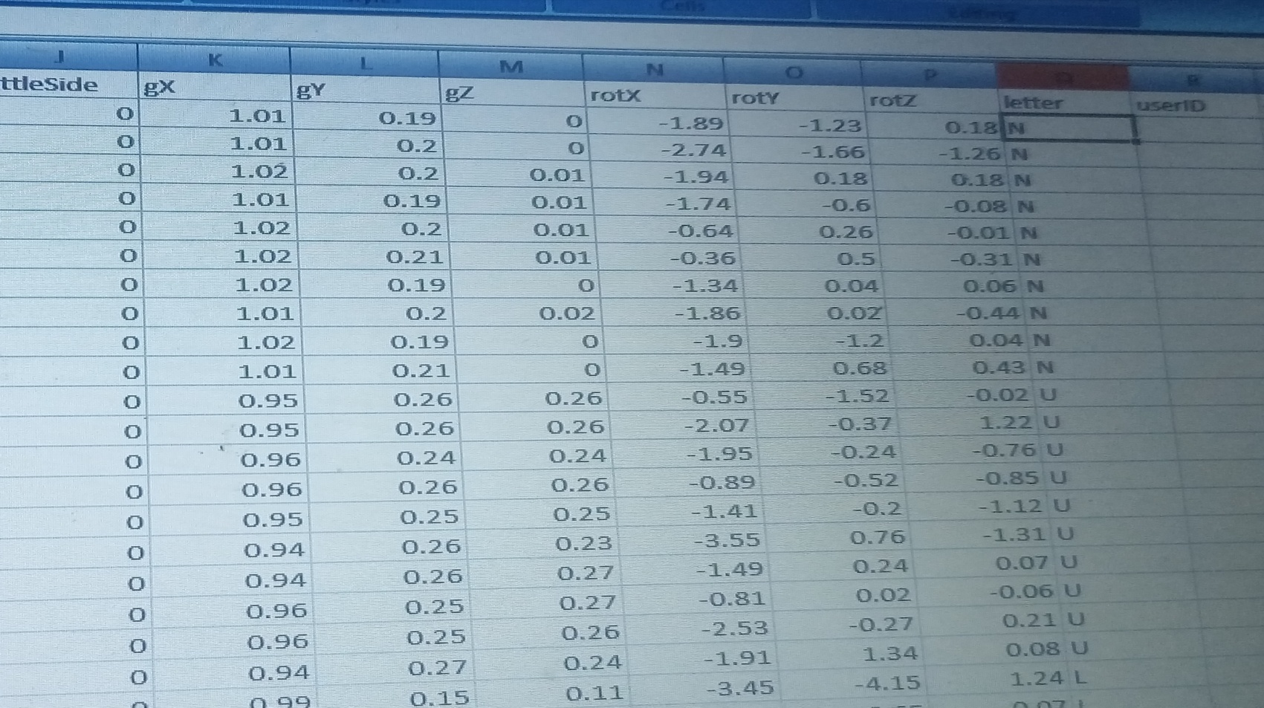
First: Data preprocessing
By addressing missing values, I ensure that the data is clean and appropriately formatted.

Slide 4
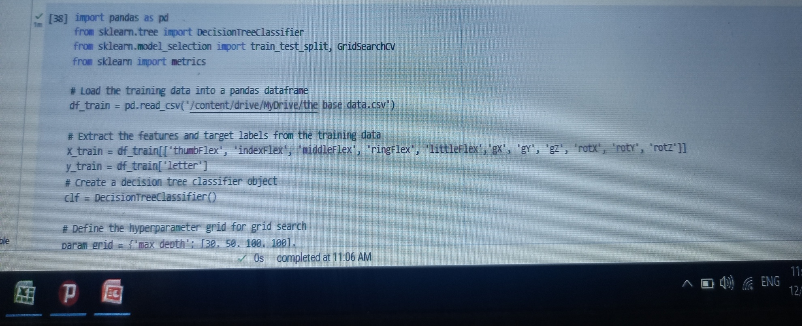
Second : Feature engineering
Using techniques such as feature selection, I choose the most essential characteristics from the dataset.

Slide 5
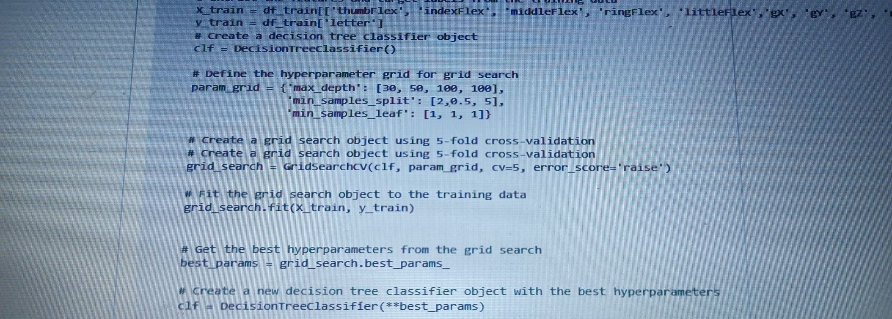
Lastly : Hyperparameter tuning
I increase the model's accuracy by applying the grid search approach to discover the ideal hyperparameter values..

Slide 6
Using the previous steps, I create a decision tree model with an accuracy of 71% and 99% for data without and data with mpu, respectively, without overfitting.

Slide 7
The affect of adding mpu
The sintifuc paper | Our experiment (flex snsors) | Our experiment (flex snsors+ mpu)
give the suggestion | accuracy =71% | Accuracy=99%

Slide 8
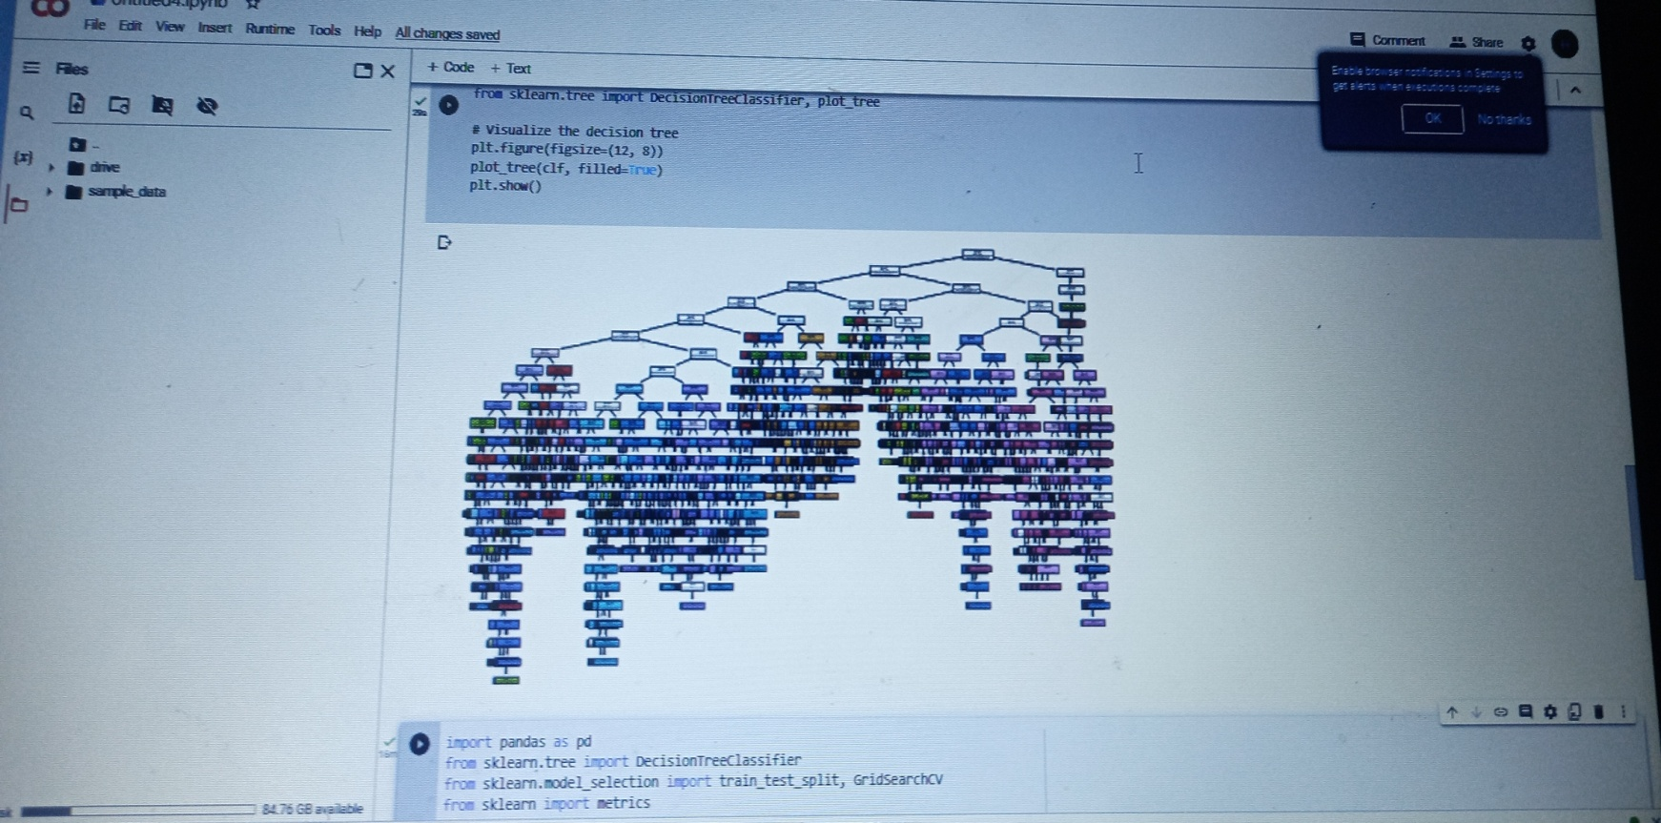
The decision tree model
I added this to the code to help anyone who looks at it understand how the tree work

